Slide 1
Silence is God’s Social Media: Seven Tips from the Saints and Science for Remaining Online with God
Catholic Medical Association National Conference
Denver, CO
9/10/22

Slide 2
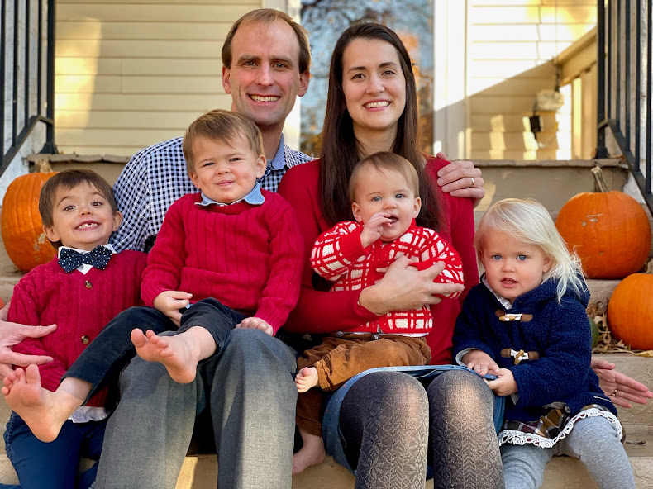

Slide 3
Introduction: The Need for Silence
“Today, in a highly technological, busy world, how can we find silence? Noise wearies us, and we get the feeling that silence has become an unreachable oasis. How many people are obliged to work in chaos that distresses and dehumanizes them? Cities have become noisy furnaces in which even nights are not spared that assault of noise.”
--Robert Cardinal Sarah, The Power of Silence.

Slide 5
“Without noise, man is feverish, lost. Noise gives him security, like a drug on which he has become dependent. With its festive appearance noise is a whirlwind that avoids facing itself. Agitation becomes a tranquilizer, a sedative, a morphine pump, a sort of reverie, an incoherent dream-world. But this noise is a dangerous, deceptive medicine, a diabolical lie that helps man avoid confronting himself in his interior emptiness. The awakening will necessarily be brutal.”
--Robert Cardinal Sarah, The Power of Silence.

Slide 6
Tip #1:
Silence is not emptiness

Slide 7
There is evidence for the use of mindfulness in:
Preventing relapse in chronic depression
(Segal, Williams, and Teasdale, 2002)
Treating Borderline Personality Disorder in Dialectic Behavioral Therapy
(Linehan, 1993)
Preventing relapse in substance abuse
(Marlatt et al, 2001)
Improving symptoms in OCD
(Baxter et al, 1992)
Improving the course of numerous other conditions including PTSD, eating disorders, and anxiety
(Hayes, Folette, and Linehan, 2004)

Slide 9
≈
ES
“These small effects are comparable with what would be expected from the use of an antidepressant in a primary care population, without the associated toxicities.”
--Goyal et al, 2015

Slide 11
“We use hope to believe something better will happen in the future, that we will arrive at peace, or the Kingdom of God. Hope becomes a kind of obstacle. If you can refrain from hoping, you can bring yourself into the present moment and discover the joy that is already here. Enlightenment, peace, and joy will not be granted by someone else. The well is within us, and if we dig deeply in the present moment, the water will spring forth.”
--Thich Nhat Hanh, Peace Is Every Step.

Slide 12
“Silence is not an absence. On the contrary, it is the manifestation of a presence, the most intimate of all presences.”
--Cardinal Sarah, The Power of Silence, p 27.

Slide 13
Tip #2:
“Silence is a presence.”
--Robert Cardinal Sarah

Slide 14
“Christian prayer is not to be looked for in an emptying of the mind, since the risen Christ is its mysterious space. All of the asceticism that accompanies prayer thus receives its focus. Its aim is not to make persons and things disappear from view; rather it purifies the relationship of the heart to all that exists, so that the heart may be where its treasure—the Lord—is. The decisive question for prayer is not the local or mental space it inhabits, but the presence that dwells in that space. This presence is in the heart as on an altar on which the Holy Spirit places and engraves the eternal Gospel: Jesus.”
--Jean Corbon, The Wellspring of Worship.

Slide 15
“For God, to give himself to us is to give us to ourselves. He gives me my being as child of God, ever springing forth anew. Experience shows that silence brings us back to ourselves. The danger would be to turn in on ourselves, and find contentment in a sort of self-complacency. To be truly oneself is to drink deeply at the wellspring of our being, or more exactly, to be the spring nourished and sustained at the heart of God himself.”
--The Wound of Love: A Carthusian Miscellany.

Slide 16
…St. John of the Cross insists that if the soul wishes to possess God, it must strip itself of all that is not God. …it must give up every satisfaction or attachment which does not lead to God. This is the meaning of his statements: ‘In order to enjoy everything [that is, to enjoy God, who is everything], do not seek to enjoy anything [do not seek any inordinate pleasure]. When you stop at anything, you do not reach the all’ (AS I, 13.11.12).’ When the soul, through some disordered attachment, stops at any creature, it interrupts its progress toward God; the nothingness of the creature prevents it from reaching the all of God.”
--Father Gabriel of St. Mary Magdalen, Divine Intimacy.

Slide 17
Tip #3:
“In order to enjoy everything, do not seek to enjoy anything.”
--St. John of the Cross

Slide 18
“What is the purpose of meditation in the sense of ‘the prayer of the heart?’ In the ‘prayer of the heart’ we seek first of all the deepest ground of our identity in God. …In the silence of this ‘night of faith’ we return to simplicity and sincerity of heart. We learn recollection, which consists in listening for God’s will, in direct and simple attention to reality. Recollection is awareness of the unconditional. Prayer then means yearning for the simple presence of God, for a personal understanding of his word, for knowledge of his will and for capacity to hear and obey him.”
--Thomas Merton, Contemplative Prayer.

Slide 19
Tip #4:
“Enlarge your desires.”
--St. Augustine

Slide 21
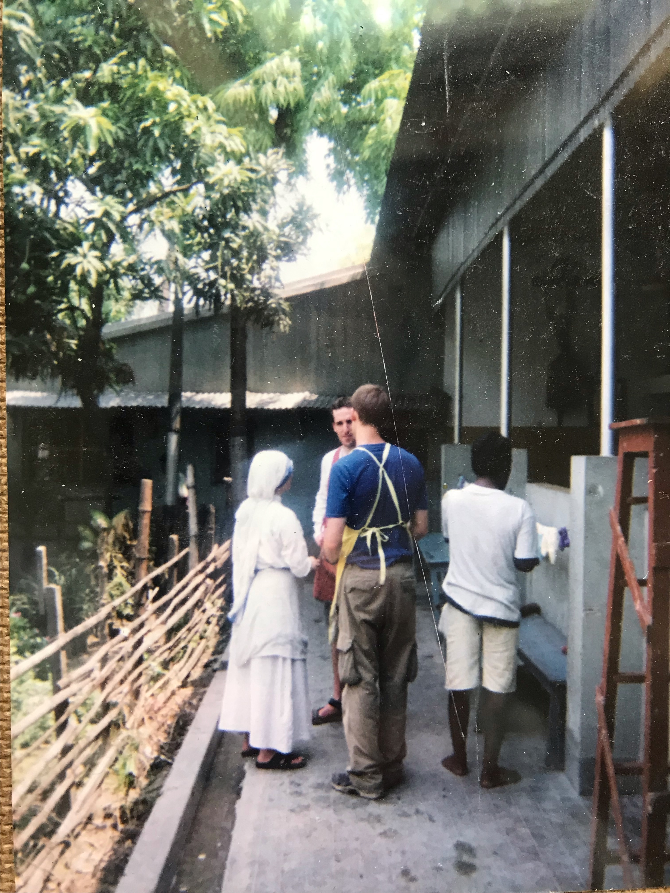

Slide 22
Why he should ask us to pray, when he knows what we need before we ask him, may perplex us if we do not realize that our Lord and God does not want to know what we want (for he cannot fail to know it) but wants us rather to exercise our desire through our prayers, so that we may be able to receive what he is preparing to give us. His gift is very great indeed, but our capacity is too small and limited to receive it. That is why we are told: Enlarge your desires….
When the Apostle tells us: Pray without ceasing, he means this: Desire unceasingly that life of happiness which is nothing if not eternal, and ask it of him who alone is able to give it.
--St. Augustine

Slide 23
“The entire life of a good Christian is in fact an exercise of holy desire. You do not yet see what you long for, but the very act of desiring prepares you, so that when he comes you may see and be utterly satisfied.
Suppose you are going to fill some holder or container, and you know you will be given a large amount. Then you set about stretching your sack or wineskin or whatever it is. Why? Because you know the quantity you will have to put in it and your eyes tell you there is not enough room. By stretching it, therefore, you increase the capacity of the sack. And this is how God deals with us. Simply by making us wait he increases our desire, which in turn enlarges the capacity of our soul, making it able to receive what is to be given to us. So, my brethren, let us continue to desire, for we shall be filled!”
--St. Augustine, Tract. 4: PL 35, 2008-2009.

Slide 24
“…if we consider the unblushing promises of reward and the staggering nature of the rewards promised in the Gospels, it would seem that Our Lord finds our desires, not too strong, but too weak. We are half-hearted creatures, fooling about with drink and sex and ambition when infinite joy is offered us, like an ignorant child who wants to go on making mud pies in a slum because he cannot imagine what is meant by the offer of a holiday at the sea. We are far too easily pleased.”
--C. S. Lewis, “The Weight of Glory.”

Slide 25
Tip #5:
“Pray ‘at all times’…pray at specific times.” --The Catechism of the Catholic Church.

Slide 26
“…to always pray and not give up.” –Luke 18:1.
“Pray without ceasing.”—St. Paul
“When the Apostle tells us: Pray without ceasing, he means this: Desire unceasingly that life of happiness.”—St. Augustine.

Slide 27
“All acts of the Christian life, whether of the intellect or not, should be accompanied by an openness for worship, like a basso continuoso accompanying the soul…”
--Hans Urs von Balthasar, Prayer.

Slide 28
“We must remember God more often than we draw breath. But we cannot pray ‘at all times’ if we do not pray at specific times, consciously willing it.”
--The Catechism, ##2697

Slide 29
Specific Times of Prayer
The Mass
Liturgy of the Hours
Rosary
The Examen
Opus Dei: Daily Mass, Rosary, 15 minutes of mental prayer, and 15 minutes of spiritual reading

Slide 30
Tip #6:
“Sit your [self] down.”

Slide 31
“The main thing is not to care if you don't feel anything -- who are we to expect to feel something and if we did we'd probably brag about it -- but don't expect not to, either. Mainly sit your [self] down, or kneel, and do it, no matter what.”
--J. C.

Slide 32
“As to prayer. You have to use the prayer which God gives you. If, at the end of the time you have given to it, you only feel that nothing has happened, and that you are humbled; be quite satisfied, and be really humble, and say to God that you desire nothing more. It would be a dreadful thing to spend time in prayer because we enjoyed it. We have to do it for God’s glory, not for our pleasure.”
--Abbot John Chapman

Slide 33
“Really I think it might do you a lot of good and give you a certain happiness to say the Rosary every day. If you don’t like it, so much the better, because then you would deliver yourself from the servitude of doing things for your own satisfaction.”
--Thomas Merton

Slide 34
“The key to a Christian conception of studies is the realization that prayer consists of attention. It is the orientation of all the attention of which the soul is capable towards God. The quality of the attention counts for much in the quality of the prayer. Warmth of heart cannot make up for it.”
--Simone Weil, “Reflections on the Right Use of School Studies with a View to the Love of God”

Slide 35
Tip #7:
“We are all beggars before God.”
--St. Augustine.

Slide 36
“He who humbles himself will be exalted; humility is the foundation of prayer. Only when we humbly acknowledge that ‘we do not know how to pray as we ought,’ are we ready to receive freely the gift of prayer. ‘Man is a beggar before God.’”
--The Catechism.

Slide 37
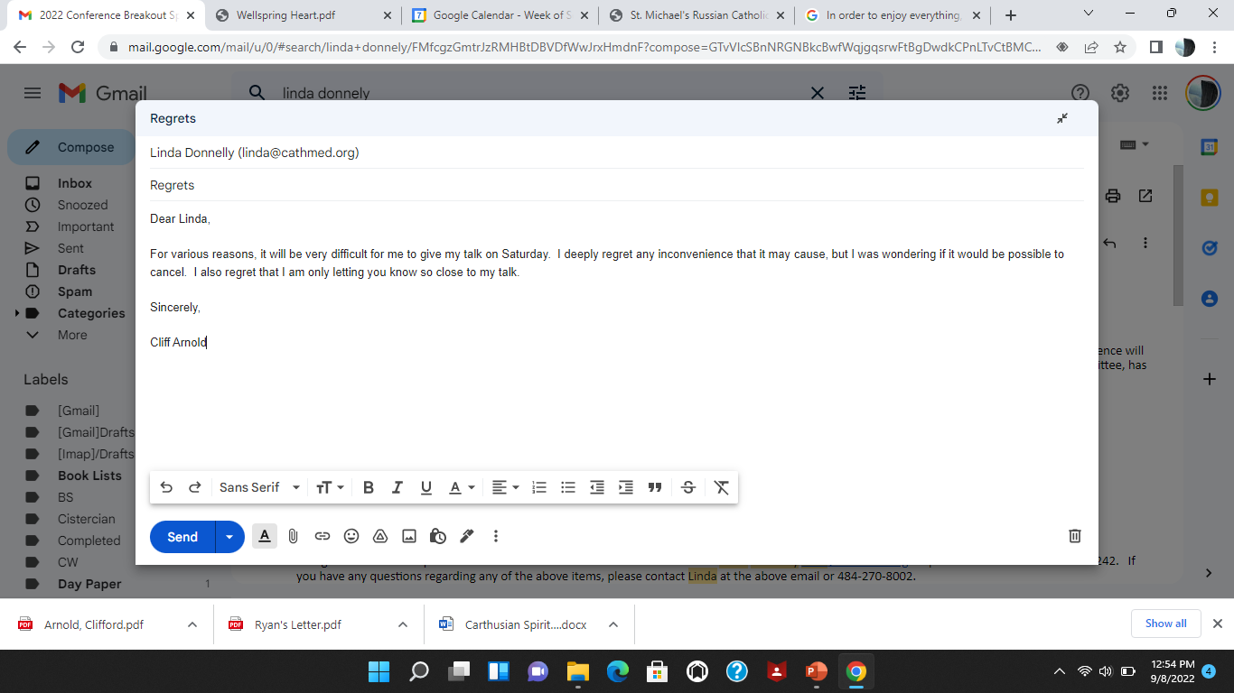

Slide 38
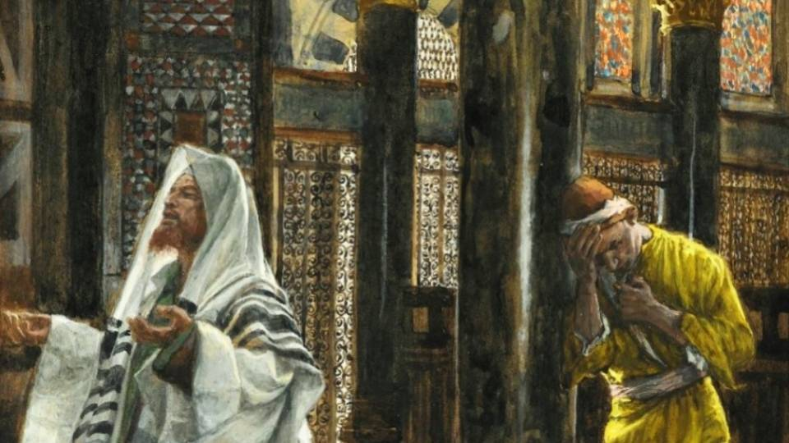

Slide 39
“I am always with you.”

Slide 40
www.inwndr.com

